Slide 1
Public transportation optimization
Done by,
Nandhini P
Manjuladevi S
Swetha G
Chinnathai A
Guided by,
Vaitheki S

Slide 2
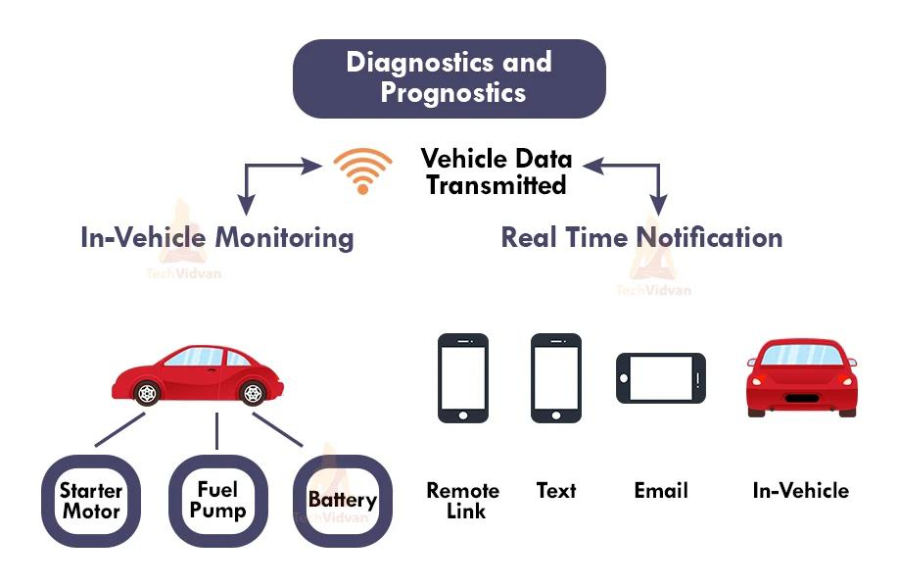
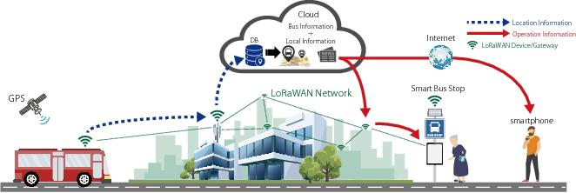

Slide 4
Synopsis
Objective
Introduction to IOT
Public transportation optimization using IOT
Benefits and challenges
conclusion

Slide 5
Objective
To develop a Smart system that could benefit RTC (Road Transport Corporation) as well as the passengers.
To develop a business model where operator can act as an Enterprise Service Provider.
To encourage the passenger to use public transport for commuting there by reducing traffic congestion, air pollution etc.
The main objective of public transportation optimization using IoT is to enhance the operational efficiency of transportation systems. By deploying IoT sensors and devices, real-time data can be collected and analyzed to optimize routes, schedules, and resources, reducing delays and improving overall system performance.

Slide 6
Introduction to IOT
The Internet of Things (IoT) refers to a vast network of interconnected devices that collect and exchange data via the internet.
These devices can range from everyday objects such as thermostats, cars, appliances, and wearable devices to industrial equipment, machinery, and smart cities infrastructure.
Internet of Things (IoT) based public transportation optimization is a smart and innovative approach to improve the efficiency, safety, and overall quality of public transportation systems.

Slide 7
Public transportation optimization
Optimizing public transportation using IoT (Internet of Things) involves the use of sensors, data analysis, and smart technologies to enhance the efficiency, safety, and convenience of transit systems.
To implement these IoT-based optimizations, a robust network infrastructure, secure data handling practices, and collaboration among transportation authorities, technology providers, and data analysts are crucial. This approach can lead to more efficient, reliable, and user-friendly public transportation systems.

Slide 8
Benefits and challenges
BENEFITS:
Improved efficiency
Accurate passenger load management
Cost saving
Enhanced passenger experience
Reduction in vehicle downtime
CHALLENGES :
High initial investment
Interoperability
Cybersecurity risks
Data overload
Scalability issues

Slide 9
Conclusion
In conclusion, IoT-based public transportation optimization holds immense promise for revolutionizing urban mobility.
By harnessing the power of Internet of Things technologies, cities and transportation authorities can unlock a wide array of benefits, including enhanced efficiency, improved passenger experience, reduced congestion, cost savings, and environmental sustainability.
By working together, they can build robust, interconnected systems that leverage real-time data to create safer, more efficient, and sustainable transportation networks.

Slide 10
THANK YOU…!

